Slide 1
AISC1003 Machine Learning I

Slide 2
Learning Outcomes – Machine Learning Intro
You will be able to differentiate between AI & ML
You will gain an appreciation for the tiny fraction of material we will be covering
You will be able to differentiate between ML & DL
You should appreciate the historical context of AI/ML and learn about important use cases

Slide 3
Exercises– Week 1
Other people’s solutions, good & bad!
Collaboration is ok on exercises.
Mandatory, but ungraded.
Taken up in class.

Slide 4
Assignment – Week 1
Other people’s solutions, BAD!
Collaboration is NOT ok on assignments.
Mandatory, graded.
Taken up in class.
If I use your solution –with your permission- I am appreciative. I may ask you to present your solution. I like short, efficient, simple code, well commented.

Slide 5
Learning Outcomes – Machine Learning Intro
You will be able to differentiate between AI & ML
You will gain an appreciation for the tiny fraction of material we will be covering
You will be able to differentiate between ML & DL
You should appreciate the historical context of AI/ML and learn about important use cases

Slide 6
Machine Learning – Intro
What is AI?
A= Artificial
I = Intelligence
A= non biological?
I= the ability to respond to a stimulus in order to achieve something
What is human intelligence?
Is knowing your right from your left ‘intelligent’?
It depends on the context.
Depends on your age, circumstance (coma), where/when you are, your culture, your peers…

Slide 7
Machine Learning – Intro
In other words, the definition changes
By today’s standards your flip phone from 20 years ago is not intelligent, but 40 years ago it would be considered AI
Voice assistants? Are they intelligent?
Computer chess even in the 80s was hard to beat!
Fundamentally the two are the same.
So how do we go about designing an AI system?
Fundamentally we study what we believe is already intelligent, and we try to replicate it
The Human Brain

Slide 8
Machine Learning – Intro
The Human Brain
Can be thought of as stochastic/deterministic
Deterministic: given the same parameters, we come to a decision the same way each time, following similar reasoning etc.
y = mx + b
Stochastically: we can say given the same parameters, if we are unable to figure out a reasoning pathway, we can still look at the decisions made and try to say there is a statistical model which predicts the brain’s decisions
Y = MX + B

Slide 9
Machine Learning – Intro
The Human Brain has:
logic (a set of rules to operate by)
memory to compare past decisions to, store current learnings
goals
intuition/probability
Computers have:
set rules
databases
optimizations
high-speed logic

Slide 10
Machine Learning – Intro
We have taken the first step towards building an AI, what is it?
describe in detail what a brain does and how it does it
If we do this well enough, then we can simulate it
Turing test: can you tell if it was a computer or human?
But eventually we hit a wall. Where/why did we fail?
don’t forget ‘A’ = artificial which means we are limited by the technology, processing speeds, manufacturing etc. vs the human brain
miniaturization, industrialization etc. allowed supercomputing

Slide 11
Machine Learning – Intro
Now we have a platform from which to study the big questions such as:
reasoning/decision-making/problem-solving
higher-order ‘thinking’
predicting/simulating/planning
thinking ahead, what-if, imagining
ontology/epistemology/mapping
how/what/why do we know?
learning/adapting
memory-based, pattern-recognition, classifying, sorting, filtering
sensing/reacting
perceiving, affecting the environment

Slide 12
Machine Learning – Intro
AI 1950s:
the ability to interact with stimulus and/or affect change in an environment as a human could
ML 1980s:
a subset of AI in which a machine mimics learning without being told how
ML AI

Slide 13
Machine Learning – Intro
ML AI
AI\ML:
AI: e.g. fast, vast, database look ups (chatbots –within parameters)
e.g. early computer chess (rules-based dictionaries)
e.g. NLP (grammar/syntax rules)
e.g. T9 text prediction (frequency-based dictionary lookup)
e.g. blockchain (authenticity, automatic, fast!)
e.g. data science
Advantages:
-speed
-simplicity
-deterministic accuracy
-understandability (no biases, explainability/cause-effect, no blackbox)

Slide 14
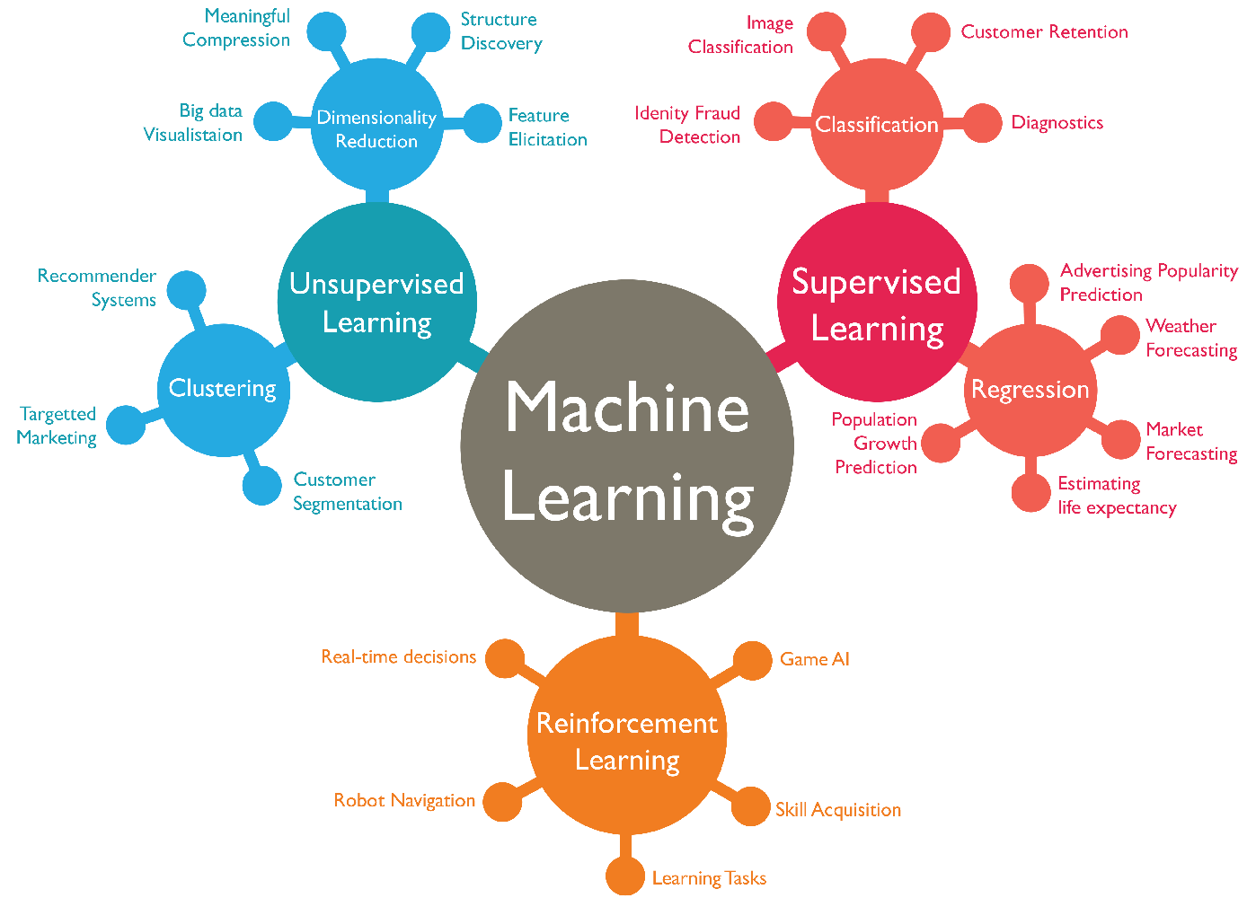
Machine Learning – Intro
ML AI
ML ⊆ AI:
Advantages:
-not stuck by rigid rules
-diverse set of problems
-stochastic accuracy
(increasing w/volume)
-?insights w/o needing
understanding (blackbox)

Slide 15
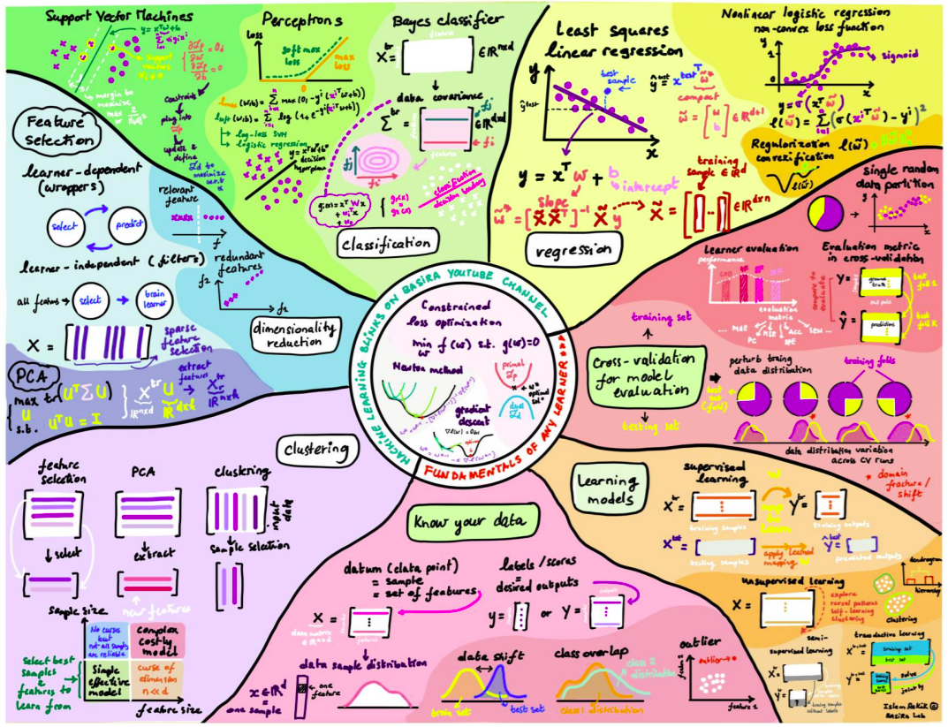
Intro –Mapping Machine Learning –Basira Lab

Slide 16
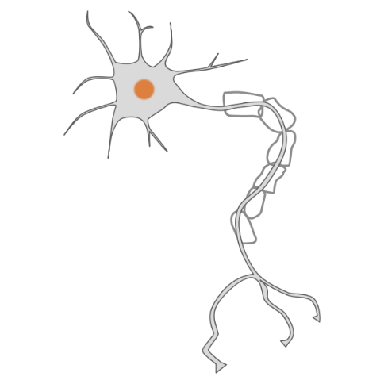
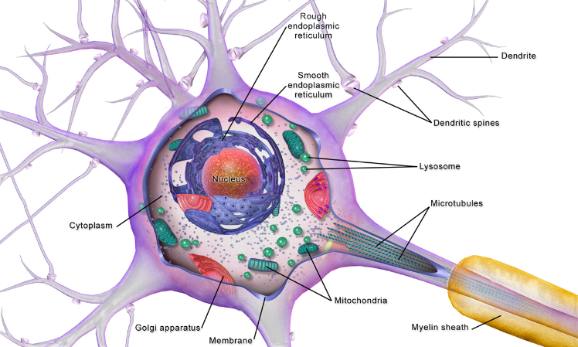
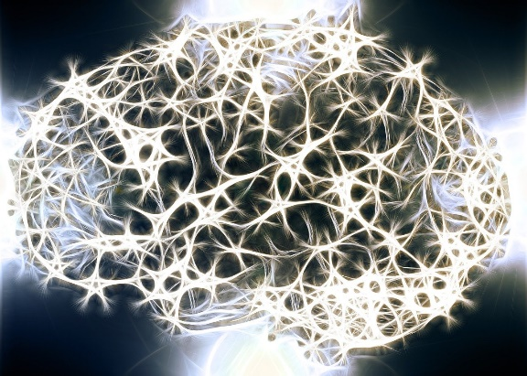
Machine Learning – Intro
DL ML
ML vs. HL
Machine Learning works by starting with an algorithm (set of instructions)
We then evaluate that algorithm, feedback to the algorithm, which improves
In humans, same thing:
If you play cricket, you miss the ball, you adjust, you try again
But remember, we are mimicking the Human Brain:
100 billion
10,000x

Slide 17
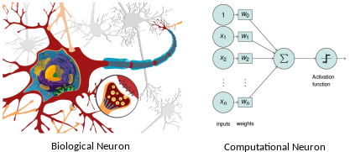
Machine Learning – Intro
DL ML
ML vs. HL
Perceptron (algorithm)

Slide 18
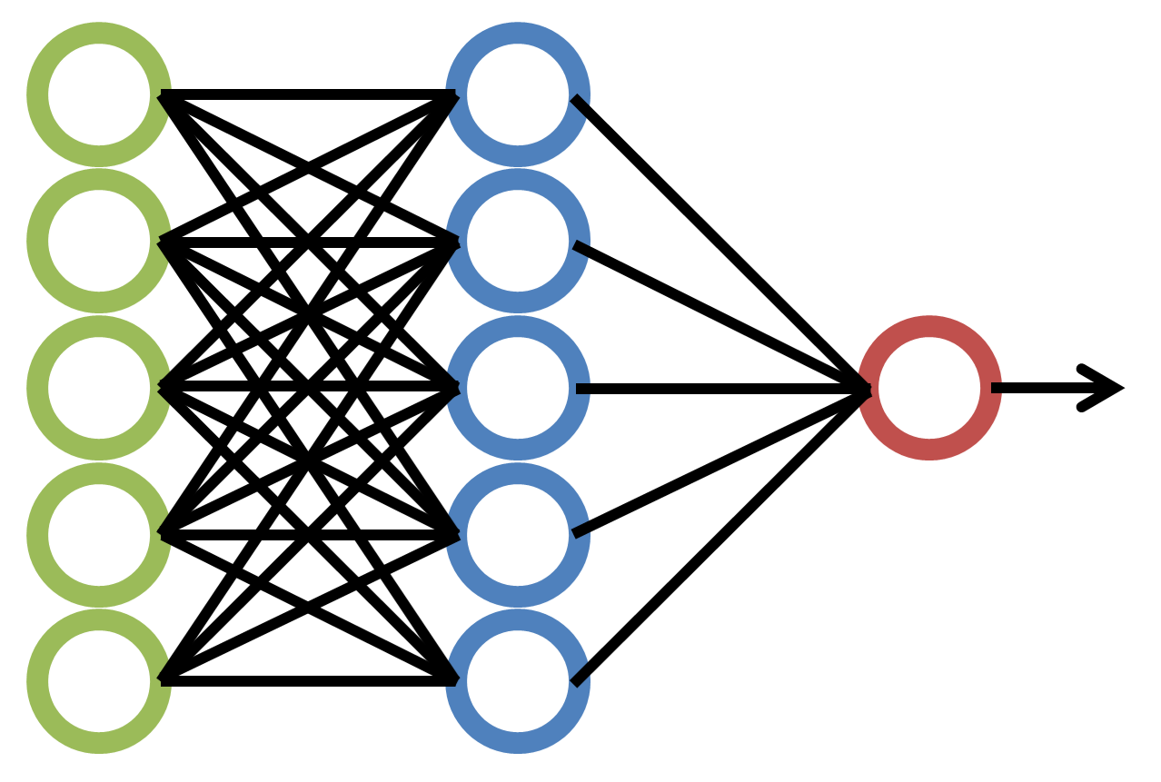
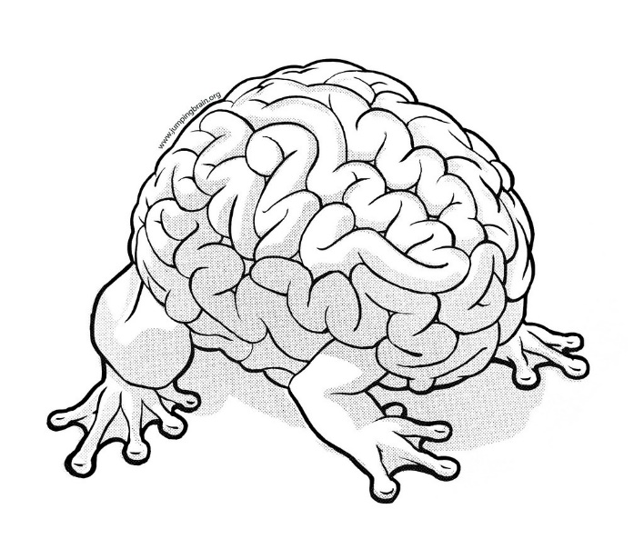
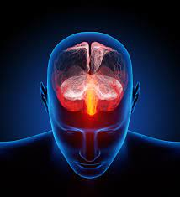

Machine Learning – Intro
DL ML
ML vs. DL
Deep (hidden) layers
Perceptron (algorithm)
100 billion vs. 1,000,000s?

Slide 19
Machine Learning – Intro
Let’s go back to the Turing Test:
-how do we know frogs think?
-how do we know other humans think?
What else can we consider?
-actions?
-choices?
-expressions?

Slide 20
Machine Learning – Intro
Homework:
-define intelligence
-define artificial intelligence
-define machine learning
Python & Excel:
Learn it!
Install it
Play with it

Slide 21
Machine Learning – Intro
https://www.python.org/about/gettingstarted/
https://www.w3schools.com/python/python_getstarted.asp
https://www.programiz.com/python-programming/first-program
https://www.programiz.com/python-programming/ide
https://www.anaconda.com/
https://edu.gcfglobal.org/en/excel/
https://exceljet.net/excel-formulas-and-functions
https://support.microsoft.com/en-us/office/use-the-analysis-toolpak-to-perform-complex-data-analysis-6c67ccf0-f4a9-487c-8dec-bdb5a2cefab6

